Slide 1
Basic of web- HTTP and Development Environment
Dr Xi Guo

Slide 2
Things to do before start
Bring your questions
Bring your curiosity
Bring your own headphone if needed

Slide 3
Pre-session activities
Have you brought your questions?
Review of the vote:

Slide 4
Content
Introduction – overview of web games
What are the advantages of web technology?
Why use web technology for games?
Web game learning path- module overview
Assessment brief
Introduction to HTTP – Understand "traffic rules" over the internet
Client-server, HTTP and URL
Introduction to the debug tool in Chrome(follow me demo)
HTTP Status Codes
Web programming
Overview of HTML, CSS and Javascript
Introduce Repl.it (follow me demo)

Slide 5
Content
Introduction – overview of web games
What are the advantages of web technology?
Why use web technology for games?
Web game learning path- module overview
Assessment brief
Introduction to HTTP – Understand "traffic rules" over the internet
Client-server, HTTP and URL
Introduction to the debug tool in Chrome(follow me demo)
HTTP Status Codes
Web programming
Overview of HTML, CSS and Javascript

Slide 6
Introduction–overview of web game
Discussion
Find some daily use web applications.
What is the advantage of web technology?

Slide 7



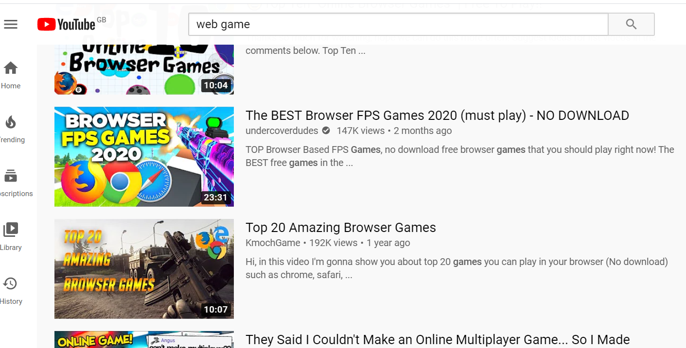

Web can be powerful
List some websites you visit everyday

Slide 8
Make your own portfolio page!
Web builder (For someone who knows how to design it but not sure how to implement it)
https://www.wix.com/portfolio-website
https://webflow.com/portfolio
Make your own website and find a host device. You need to learn more (independent learning)
https://youtu.be/Dtb3DdSvYRY?si=Bk0BgHL4aITEYi0k

Slide 9

Web can be beautiful and fun
Action: check and explore the webpages listed below
Find out what functionality they have
Try the links on both PC and mobile devices(Please copy the URL to your browser to visit. )
https://www.thepxa.co.uk/Welcome
https://codepen.io/ScavengerFrontend/full/xxGwjox
https://codepen.io/jh3y/full/RwPrOoz
Web Game market
https://itch.io/
Three. Js sample projects
https://threejs.org/
Notes:
Reference :
https://tympanus.net/codrops/2020/03/03/awesome-demos-roundup-14/

Slide 10
Content
Introduction – overview of web games
What are the advantages of web technology?
Why use web technology for games?
Web game learning path- module overview
Assessment brief
Introduction to HTTP – Understand "traffic rules" over the internet
Client-server, HTTP and URL
Introduction to the debug tool in Chrome(follow me demo)
HTTP Status Codes
Web programming
Overview of HTML, CSS and Javascript
Introduce Repl.it (follow me demo)

Slide 11


Why use web technology for games?
The web is ubiquitous. It allows distribution of games anytime and anywhere – Including across platforms
Marketing and discoverability are improved. Directly communicate with the client.
You have control where it matters- Full DIY through the business chain and lifecycle of the game. For example, updates, launches, payments, data analysis etc.
Rich resources for game engines, javascript library and large community to support learning.
Great potential to extend to other area like web art, web applications, web simulations.
A web game engine list (http://html5gameengine.com/)
Notes:
Referenced from :
https://developer.mozilla.org/en-US/docs/Games/Introduction
The business case

Slide 12
When not to use web technology for games
Difficulty with loading large real time multimedia resources (for example - video and 3D content)​
Can be affected by different browsers / personal devices​
Can be difficult to find problems​
Harder to use hardware features within devices (affects webAR)​
Security issues and cross domain issues.

Slide 13

How to transfer web pages to a game?
Actives: Play the game below and use your existing knowledge to analyse it. Can you tell what technology it is using?
https://beinternetawesome.withgoogle.com/en_us/interland
Notes:
More game review here:
https://youtu.be/5b2vzK7F3SQ

Slide 14
Discussion: Where are your skills?
Imagine you have been asked to make this web game.
How are you going to design it?
What technology will you need to use?
Where are you going to start?
What do you feel you are most likely to struggle with?

Slide 15
Content
Introduction – overview of web games
What are the advantages of web technology?
Why use web technology for games?
Web game learning path- module overview
Assessment brief
Introduction to HTTP – Understand "traffic rules" over the internet
Client-server, HTTP and URL
Introduction to the debug tool in Chrome(follow me demo)
HTTP Status Codes
Web programming
Overview of HTML, CSS and Javascript
Introduce Repl.it (follow me demo)

Slide 16
Web game learning path
The module material has been designed to take everyone from a beginner to full stack web game developer efficiently
Learning through guided activities and lab practise
Learning is guided by your questions (So submit your questions!!!)
Blended learning: Self-learn with selected resources on Moodle is required
Multiple communication channels: Survey, MS team, Emails， Discord discussion

Slide 17
Web game learning path - Module overview
Basic web theory and programming languages (foundation)
HTTP protocol
IDE set up Debug method
HTML5 and CSS
Javascript, ES6
Javascript libraries and development stacks
Use HTML multi-media, canvas for game development
Client-side web 3D graphic basic programming
ThreeJS
WebGL

Slide 18
Web game learning path - Module overview
Interaction and Server-side programming
Client-server
Use Node.js, Express.js for server set up
Communication between client-side and server-side
REST API and web services
State maintain : Session, Cookie
Data
Data storage and web data format
Basic database introduction
SQL introduction
Build web game with database support

Slide 19
Web game learning path - Module overview
Server settings and game publishing
HTTPS and CROS-domain
Putting things together
Local server setup
Q&A and the way forward

Slide 20
Content
Introduction – overview of web games
What are the advantages of web technology?
Why use web technology for games?
Web game learning path- module overview
Assessment brief
Introduction to HTTP – Understand "traffic rules" over the internet
Client-server, HTTP and URL
Introduction to the debug tool in Chrome(follow me demo)
Web programming
Overview of HTML, CSS and Javascript

Slide 21
Assignment brief
Please check Assignment brief on Moodle

Slide 22
Content
Introduction – overview of web games
What are the advantages of web technology?
Why use web technology for games?
Web game learning path- module overview
Assessment brief
Introduction to HTTP – Understand "traffic rules" over the internet
Client-server, HTTP and URL
Introduction to the debug tool in Chrome(follow me demo)
Web programming
Overview of HTML, CSS and Javascript

Slide 23
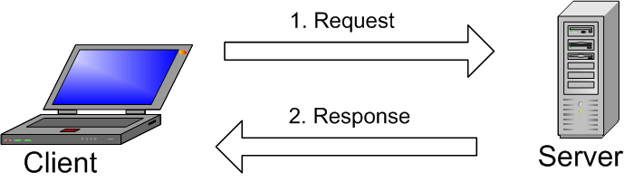
Client-server
This Photo by Unknown Author is licensed under CC BY-SA

Slide 24
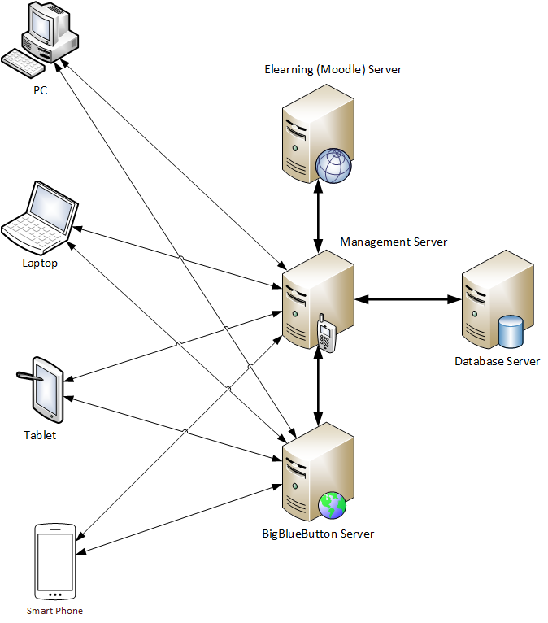
Client-server
This Photo by Unknown Author is licensed under CC BY-SA

Slide 25
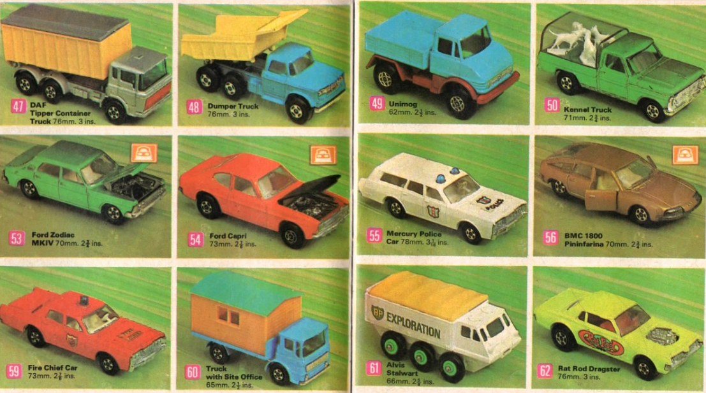

Learn to "drive" the web – do you know the rules?
Notes:
Image reference from :
https://pxhere.com/en/photo/197852

Slide 26
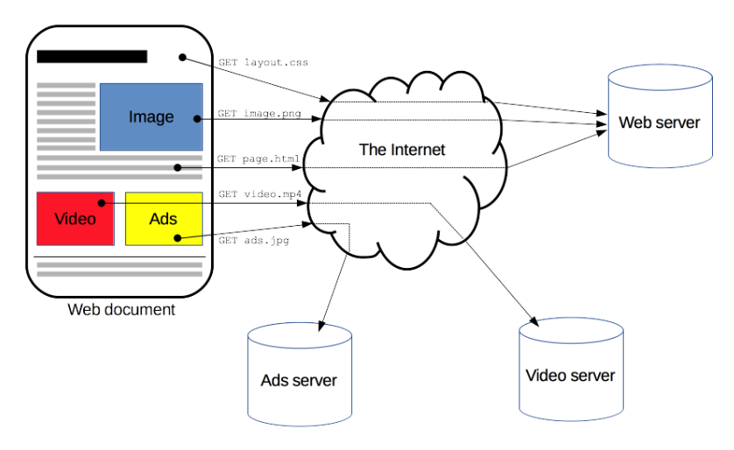
Delivery over internet –HTTP and HTML
Original from:
https://developer.mozilla.org/en-US/docs/Web/HTTP/Overview (16/09/2023)
Notes:
Referenced from:
https://developer.mozilla.org/en-US/docs/Web/HTTP/Overview

Slide 27

URL- the address of the web resources
Watch the video below and learn the format of URL.
https://youtu.be/5Jr-_Za5yQM
This Photo by Unknown Author is licensed under CC BY

Slide 28

URL- the address of the web resources
Watch the video below and learn the format of URL.
https://youtu.be/5Jr-_Za5yQM
top-level domain
This Photo by Unknown Author is licensed under CC BY

Slide 29
Content
Introduction – overview of web games
What are the advantages of web technology?
Why use web technology for games?
Web game learning path- module overview
Assessment brief
Introduction to HTTP – Understand "traffic rules" over the internet
Client-server, HTTP and URL
Introduction to the debug tool in Chrome(follow me demo)
HTTP Status Codes
Web programming
Overview of HTML, CSS and Javascript

Slide 30
Activities: Inspect the HTTP request and response (Follow me Demo)
Demo on how to use google development tool (follow me demo)
Find out what information is embedded in the HTTP head to the link below:
https://www.w3schools.com/html/tryit.asp?filename=tryhtml_images_trulli

Slide 31
Use google chrome debug tools
Practise using google chrome debugging tools (text).
https://developers.google.com/web/tools/chrome-devtools
Watch the tutorial below to use the google chrome developer tools.(You need to login using your university account)
https://www.linkedin.com/learning-login/share?account=42288921&forceAccount=false&redirect=https%3A%2F%2Fwww.linkedin.com%2Flearning%2Flearning-chrome-web-developer-tools-2%3Ftrk%3Dshare_ent_url%26shareId%3DyKoRRVZjQCKCdY5iqoQDTA%253D%253D
Please contact the ICT if you can’t login the LinkedIn Learning
Notes:
https://www.linkedin.com/learning-login/share?forceAccount=false&redirect=https%3A%2F%2Fwww.linkedin.com%2Flearning%2Flearning-chrome-web-developer-tools-2%3Ftrk%3Dshare_ent_url&account=42288921

Slide 32
Activities- Demo
Now go back to the link and find the error message request/response information(May not available after the session)
https://www.w3schools.com/html/tryit.asp?filename=tryhtml_images_trulli

Slide 33
Content
Introduction – overview of web games
What are the advantages of web technology?
Why use web technology for games?
Web game learning path- module overview
Assessment brief
Introduction to HTTP – Understand "traffic rules" over the internet
Client-server, HTTP and URL
Introduction to the debug tool in Chrome(follow me demo)
HTTP Status Codes
Web programming
Overview of HTML, CSS and Javascript

Slide 34
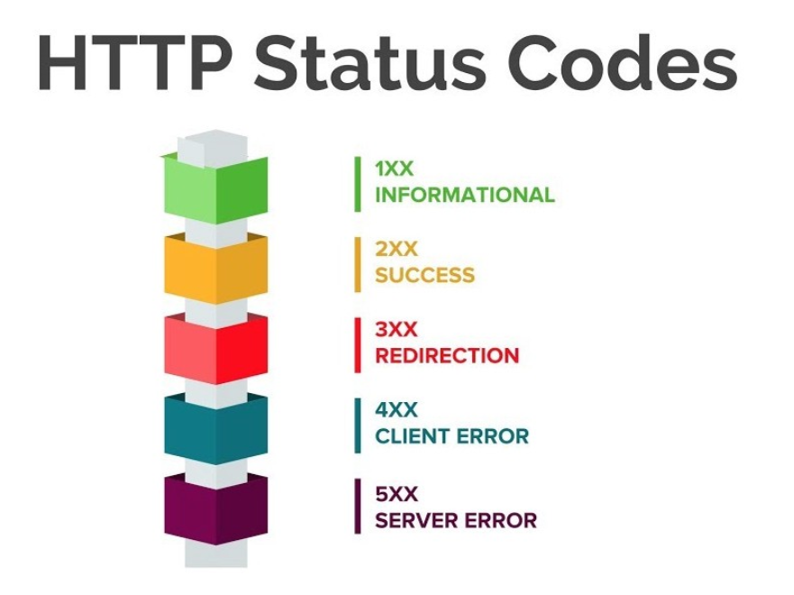
HTTP response status codes
https://developer.mozilla.org/en-US/docs/Web/HTTP/Status
200 – well done! You get in!
400 - What are you talking about?!
403 – No, you are not allowed!
404 – Woops... nothing here.
500 - Server SOS!
Notes:
Image from :
https://www.youtube.com/watch?v=LtNSd_4txVc

Slide 35
Please use these codes in the class
200 – I understand it . No questions
400 - What are you talking about?! Repeat please
404 – This person is not here
500 - Server SOS! I need help. I have a bug in my code

Slide 36
Activities- follow me demo
Use the google chrome development tools to check below webpage. (only available during the lesson)
https://www.w3schools.com/html/tryit.asp?filename=tryhtml_images_trulli
Check the console options
Check the network options
Check the source options
Can you tell what is included in this web page?

Slide 37
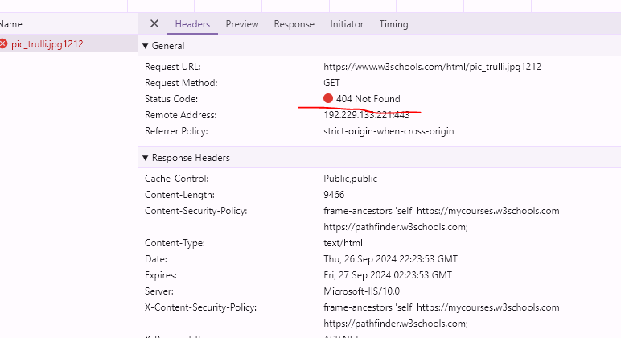
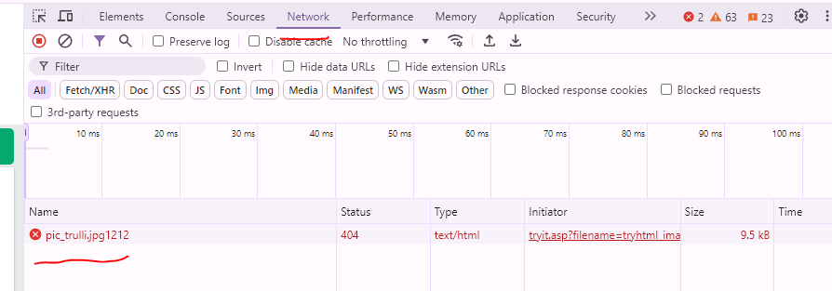
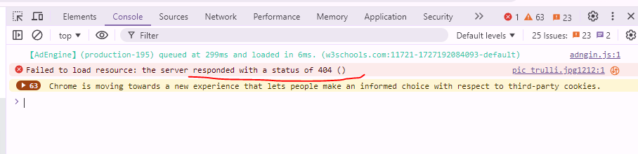
HTTP Header

Slide 38
Content
Introduction – overview of web games
What are the advantages of web technology?
Why use web technology for games?
Web game learning path- module overview
Assessment brief
Introduction to HTTP – Understand "traffic rules" over the internet
Client-server, HTTP and URL
Introduction to the debug tool in Chrome(follow me demo)
HTTP Status Codes
Web programming
Overview of HTML, CSS and Javascript

Slide 39
HTML, CSS and javascript
HTML(Hyper Text Markup Language) is the document that contains web content –HTML5 is the latest evolution of the standard that defines HTML.
CSS(Cascading Style Sheets) is the document that define the style and look of a web page.
Javascript is the script that controls the interaction and events on the web page.
Notes:
https://www.linkedin.com/learning-login/share?forceAccount=false&redirect=https%3A%2F%2Fwww.linkedin.com%2Flearning%2Fcss-essential-training-3%3Ftrk%3Dshare_ent_url&account=42288921

Slide 40
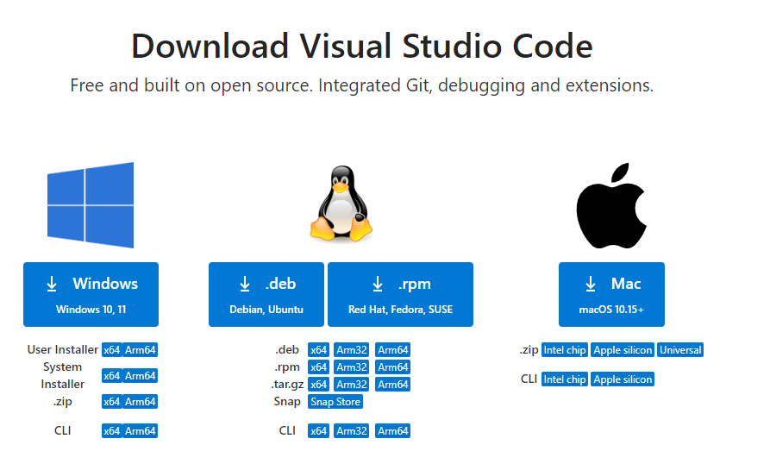
Download VS code
https://code.visualstudio.com/download
Window *64 .zip version(or any other version matches your Operating System )

Slide 41
Get start
Intro Videos - Begin your journey with VS Code through these introductory videos.
Setup - Install VS Code for your platform and configure the tool set for your development needs.
User Interface - Introduction to the basic UI, commands, and features of the VS Code editor.
Settings - Customize VS Code for how you like to work.
Languages - Learn about VS Code's support for your favorite programming languages.
Node.js - This tutorial gets you quickly running and debugging a Node.js web app.
Tips and Tricks - Jump right in with Tips and Tricks to become a VS Code power user.
Azure - VS Code is great for deploying your web applications to the cloud.
Extension API - Learn how to write a VS Code extension.
Why VS Code? - Read about the design philosophy and architecture of VS Code.

Slide 42
IDE introduction and demo
VS code demo
You can also use online tools
Repl.it (no free education account anymore)
https://codepen.io/
Remember to back up !!! (You can use Git tools)

Slide 43
Questions?

